Slide 1
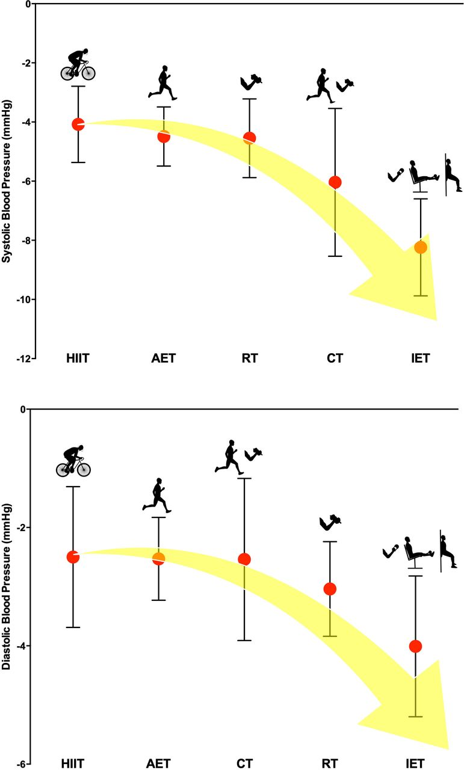

Central illustration.
Jamie J Edwards et al. Br J Sports Med 2023;57:1317-1326
Copyright © BMJ Publishing Group Ltd & British Association of Sport and Exercise Medicine. All rights reserved.
Notes:
Central illustration. AET, aerobic exercise training; CT, combined training; HIIT, high-intensity interval training; IET, isometric exercise training; RT, dynamic resistance training.

